Slide 1
Health and Wholeness

Slide 2
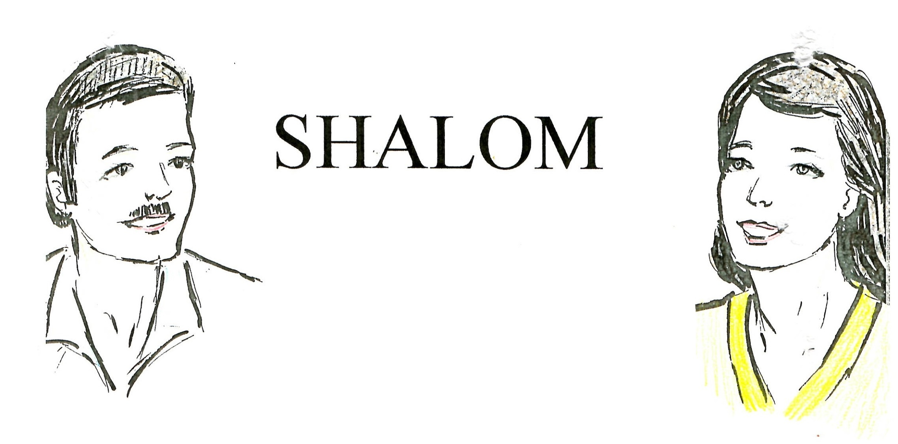
HELLO!
GOOD DAY!
God Bless You

Slide 3
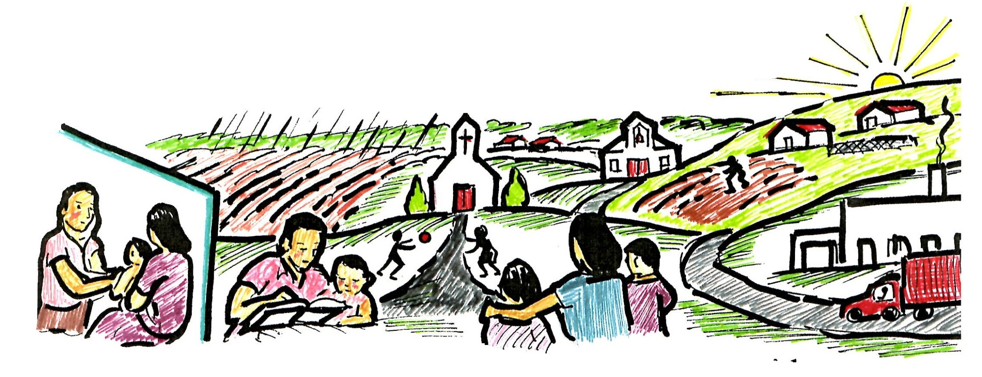
The SHALOM greeting means that I wish for you all that God has wished for his children. A good life, with health, happiness, enough food, an abundant harvest, enough rain, a happy family, work that you like, freedom, peace with justice and spiritual salvation.
In order to have SHALOM as a community, religious groups, schools, health centers, businesses, and families have to work together.

Slide 4
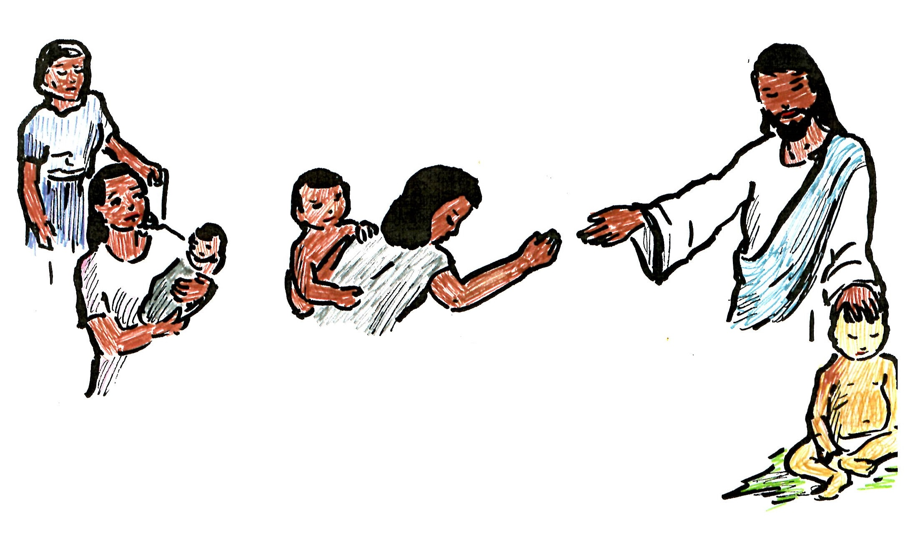
When Jesus walked on Earth, he told people to be compassionate. He wanted others to follow his example. He said that when we serve the hungry, the naked, the sick and the incarcerated, we serve him.
We cannot follow Jesus example, and hate other people. Everyone included! Rich, poor, powerful, weak, religious, non religious, educated, or not… No exceptions!

Slide 5
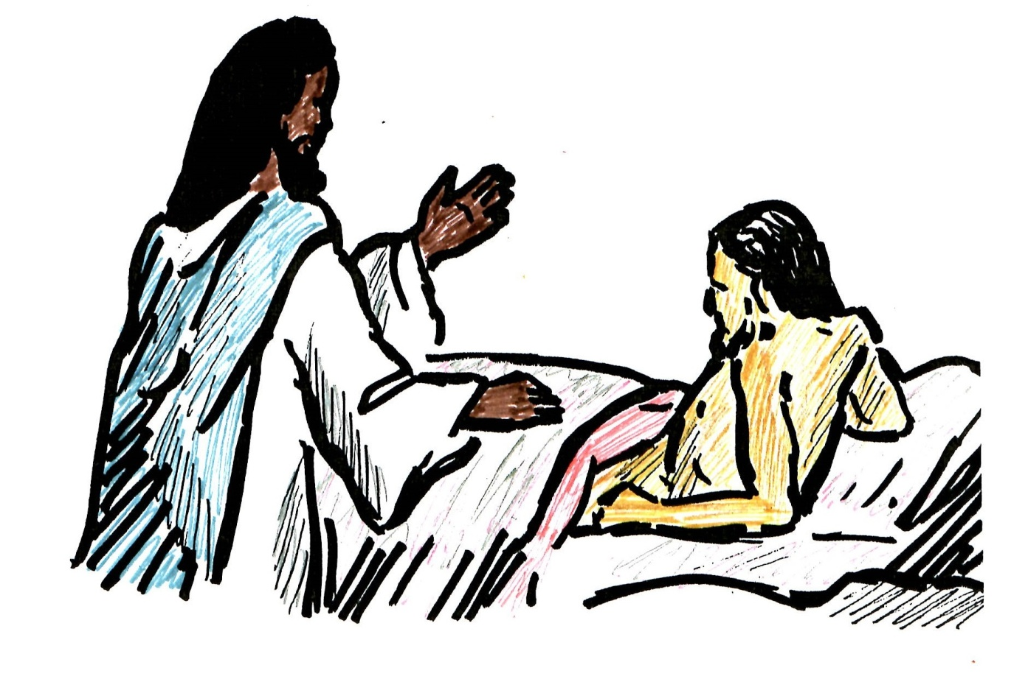
Jesus demonstrated his love in human suffering, feeding the hungry, healing the sick, and comforting the afflicted. He confronted those who abused the vulnerable of society.

Slide 6
True religion changes how we live our personal lives, but doesn’t stop there.

Slide 7
When people become truly religious, they have a change of heart! They will begin to work together to protect innocent children, the humble, and the poor, rather than selfishly hoarding all the best things.

Slide 8
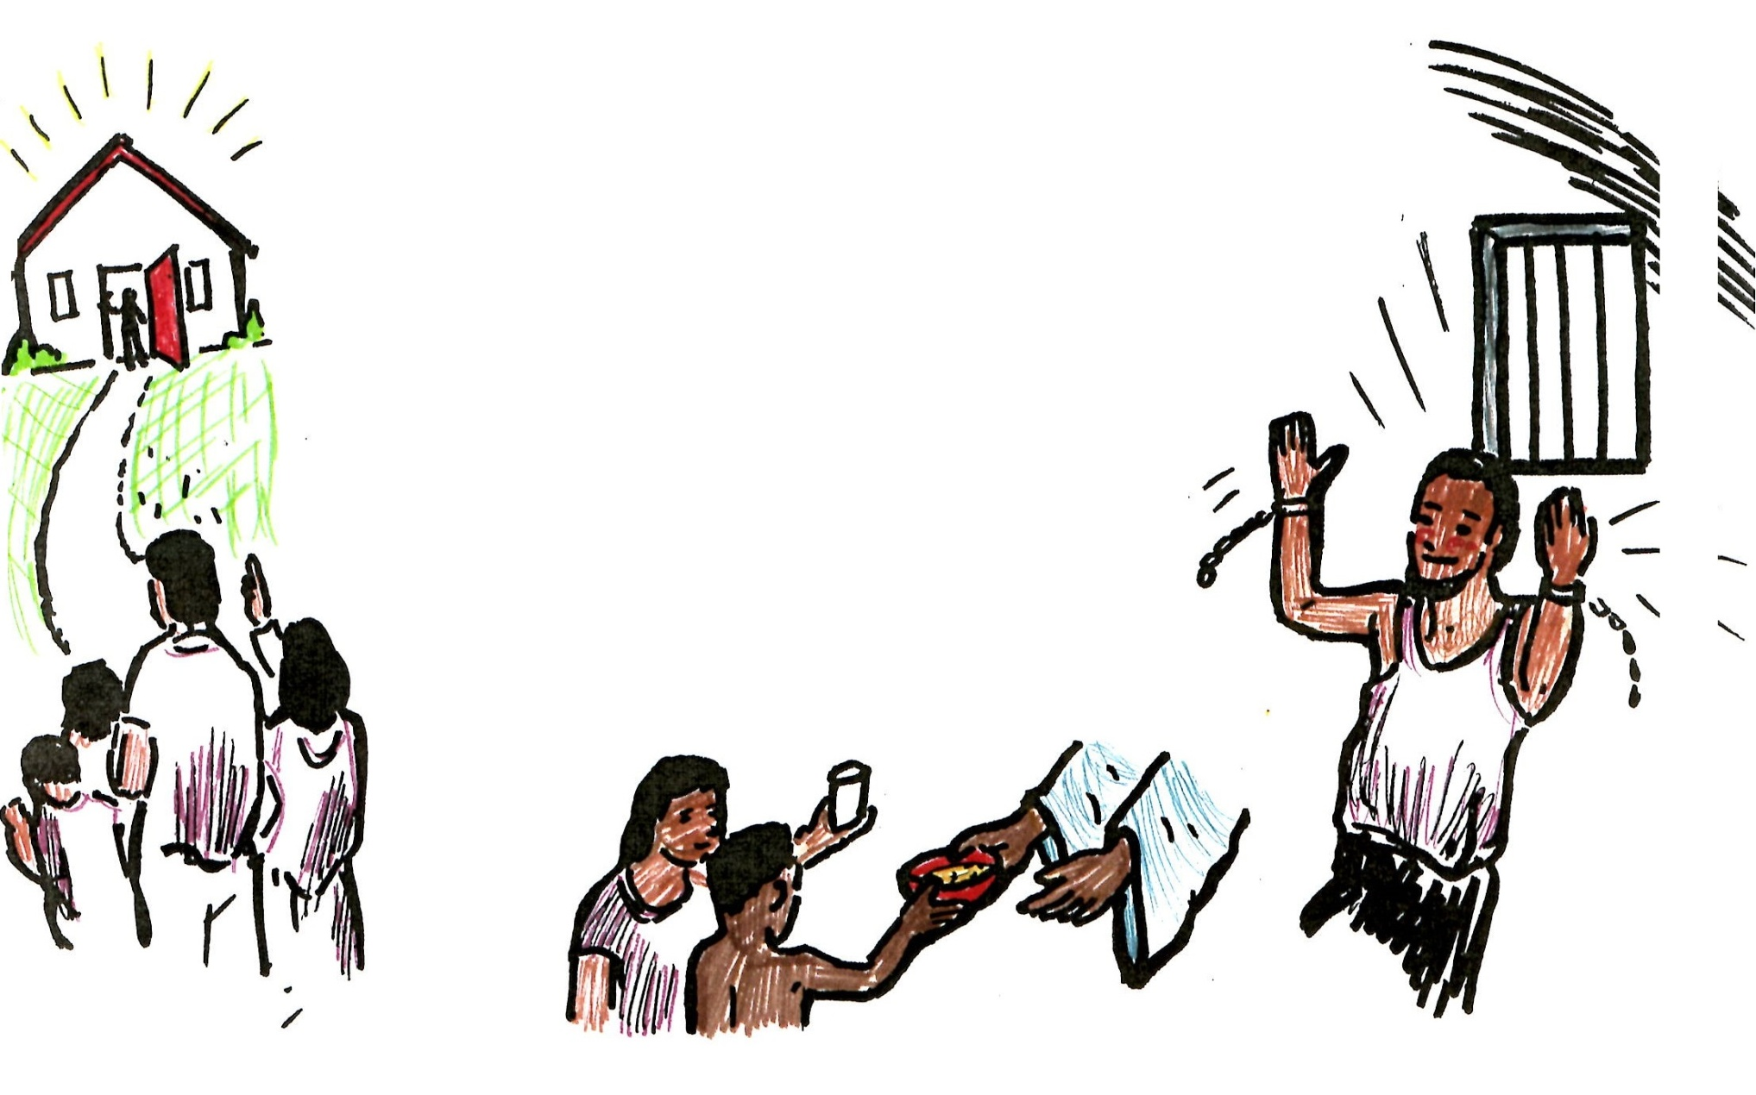
In the bible, God says that his fury burns when he hears the cries of the innocent who are afflicted by the powerful. God’s commands to his children are:
Untie cords of injustice
Remove the burdens of oppression
Share your bread with the hungry
Give shelter to the poor wanderers
God wants laws to be fair and justice to be given to everyone!

Slide 9
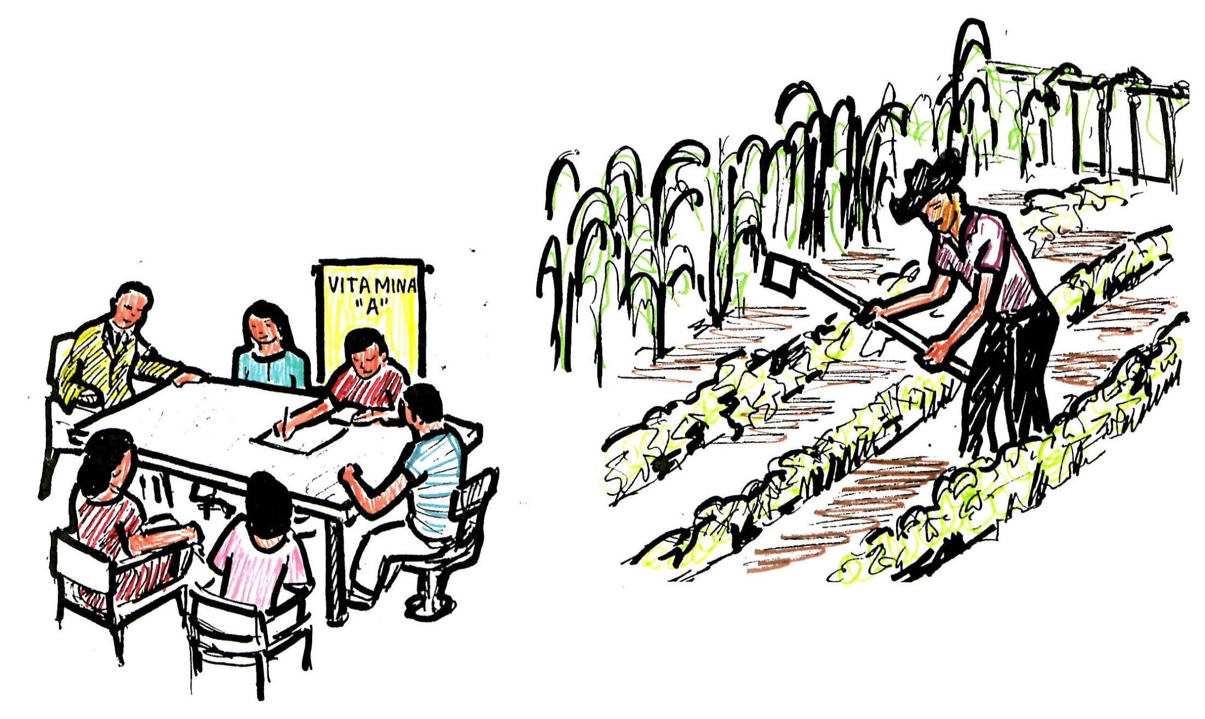
When the people of faith work together in, they can have a strong do great things together their entire community.
Community Activities
Garden Projects

Slide 10
If we spend our lives fighting with each other, we abandon society
VIOLENCE
IMMORALITY
EXPLOITATION
DRUGS
ALCOHOL
WELCOME

Slide 11
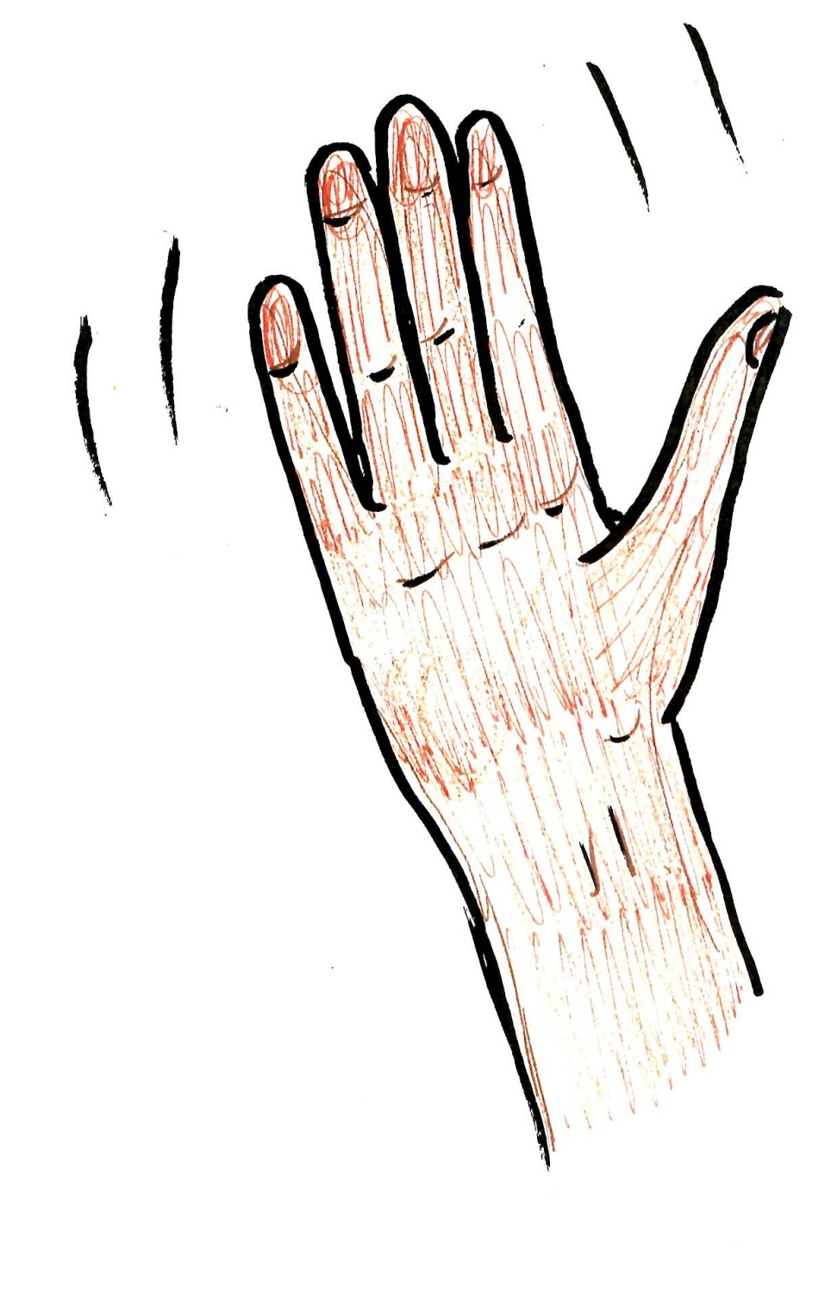
Goodbye!
SHALOM
Go with God

